Slide 1



API Management
Publish, manage, secure, and analyze your APIs in minutes
Raphael Bickel | Cloud Solution Architect | Microsoft
January 20th, 2019

Slide 2
Agenda
API Management, what does it solve ?
Features overview
Demo
Questions

Slide 3
Digital Transformation runs on APIs
Connected experiences
APIs
Services and data
Notes:
API helps Transformation and optimization
Enable new business models
Centric strategies
Innovative business models
New connected experiences
Are enabled by API
APIs are abstraction. Decoupled consumption from implementation
APIs are reusable. Long period of time, used by many customers
HTTP APIs. Extremely well adopted. Standards, Open APIs
Available on any platform by any programming language
Building and consuming an API is a solved problem
Flexibility
Can change the backend architecture, location, transport without impacting the API
Front door for authentication, metering
Evolve backend APIs
Enable
Enable developers to find APIs
Test APIs

Slide 4

API management solves API-related challenges
Discover
Learn
Get access
Try
SDKs and samples
Get help
Connected experiences
Abstract
Secure and protect
Manage lifecycle
Monitor and measure
Onboard developers
Monetize
Consume
Mediate
Publish
Developer portal
Gateway
Azure portal
APIs
Developers
(use APIs)
Publishers
(provide APIs)
Services and data
Notes:
How API management solves API related problems
Gateway is a mediation layer

Slide 5








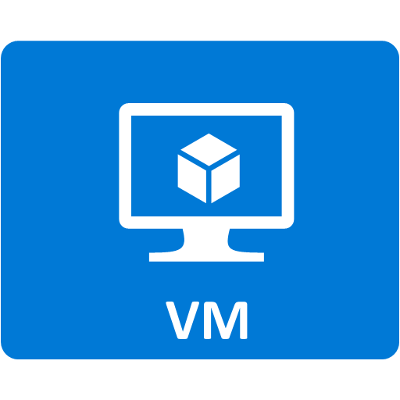

Façade and front door
Developer portal
Consume
App developers
Gateway
Mediate
1st and 3rd party apps
contosoapi-foo.azurewebsites.com
Azure portal
Publish
APIs on Azure and outside
API managers and developers

Slide 6
Façade and front door
Gateway
Mediate
contoso.azure-api.net/foo
contosoapi-foo.azurewebsites.com
1st and 3rd party apps
api.contoso.com/foo
contosoapi-bar.azurewebsites.com
Notes:
Façade and front door of your APIs
Accepts API calls and routes them to your backends.
Verifies API keys, JWT tokens, certificates, and other credentials.
Enforces usage quotas and rate limits.
Transforms your API on the fly without code modifications.
Caches backend responses where set up.
Logs call metadata for analytics purposes.

Slide 7







Security and protection
Username/Password
Internet IPs
Microsoft account
Google account
Facebook account
Twitter account
Delegated (custom)
Azure AD
Azure AD B2C
Developer portal
App developers
Consume
Key
OAuth 2 & OpenID Connect
Client certificate
Custom external authorizer
IP filter
Rate limits and quotas
Gateway
HTTP Basic
Mutual certificate
Shared secret
IP filter
VNET/NSG
Mediate
1st and 3rd party apps
Azure portal
Azure account
RBAC
APIs on Azure and outside
Publish
API publishers

Slide 8
VNETs and Hybrid
Developer portal
Consume
App developers
VNET
Gateway
Mediate
1st and 3rd party apps
Azure portal
Publish
APIs on Azure and outside
API managers and developers

Slide 9



VNETs and Hybrid
VPN
VNET
Gateway
Mediate
1st and 3rd party apps
Notes:
External
Internal
VPN/Express route

Slide 10
API Gateway Policies
Encapsulate common API management functions
Access control, Protection, Transformation, Caching, …
Mutate request or context or change API behavior
Add a header or throttle for example
Set for inbound and outbound directions
Applied at a variety of scopes or on error
Scope determines which APIs are affected
Can define custom scopes in addition to four available b default

Slide 11

Regional availability
29 public regions in Americas, Europe, Asia and Australia
Central US Early Update Access Program (EUAP) region
6 US Gov and 4 China regions
France Central is coming soon

Slide 12
Multi-region topologies

Slide 13

Multi-region topologies
Secondary
region
Primary
region

Slide 14
Multi-region topologies
Secondary
region
Primary
region

Slide 15
Multi-region topologies
Secondary
region
Primary
region
Shared state
Hint: use <choose> to <set-backend> policy based on context.Deployment.Region

Slide 16
Multi-region topologies
Secondary
region
Primary
region
Shared state

Slide 17
Multi-region topologies
Secondary
region
Primary
region
Shared state

Slide 18
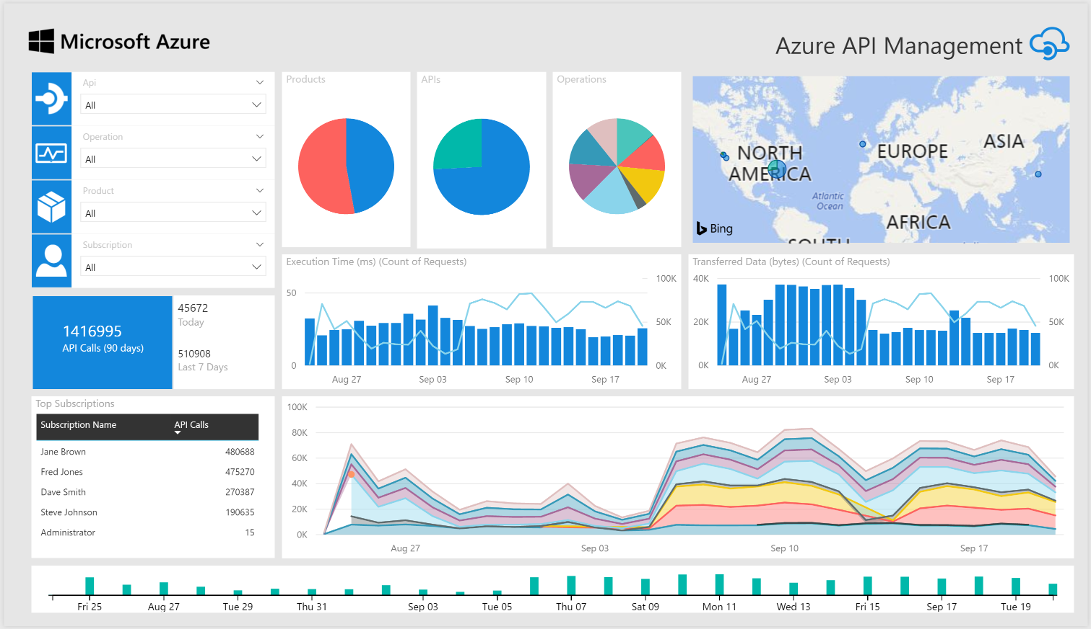
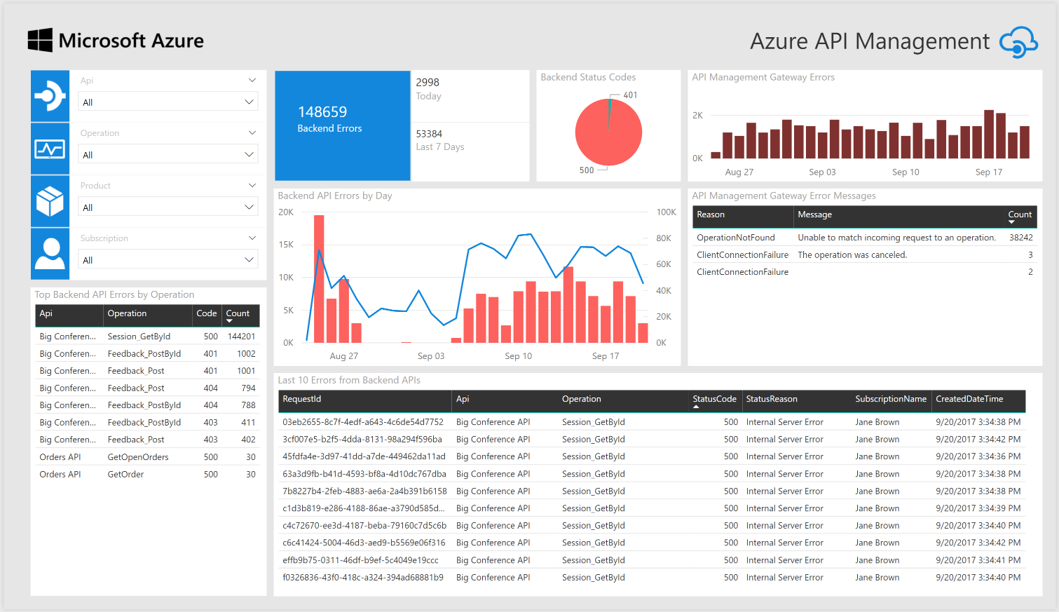
Monitoring and troubleshooting
API Inspector
Built-in reports
Azure Monitor metrics
Application Insight
Power BI
Event Hub

Slide 19


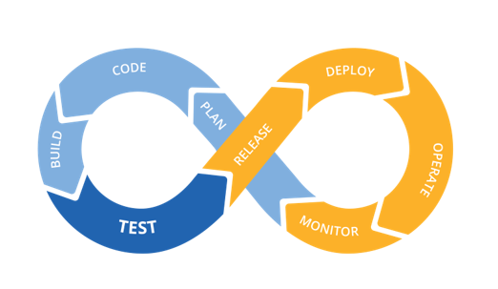





DevOps pipeline
ARM Templates
API Management
App Insights
Azure Monitor

Slide 20
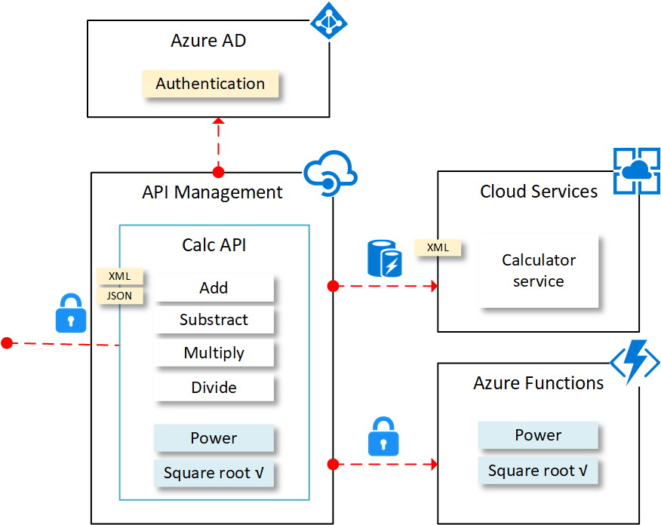
Demo

Slide 21
And much more
Custom domains/SSL
SOAP and SOAP to REST
DevOps pipeline
C# snippets
Secrets and variables
KeyVault integration
Capacity metric and auto scale
API publishing with products, users and groups
Developer portal customization
Real-time monitoring with App Insight
Metrics, Azure Monitor, Alerts
Event Hub

Slide 22
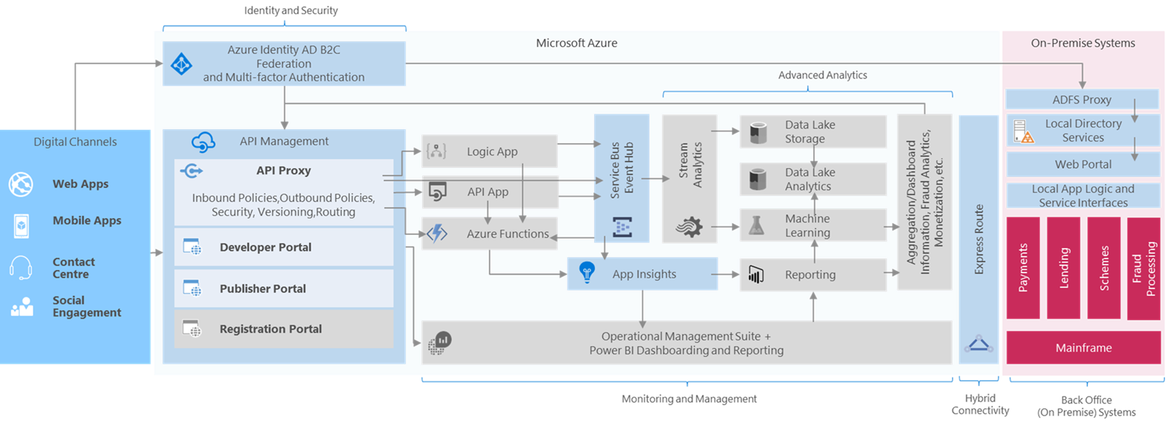
APIs are just the start

Slide 23

Questions
Resources:
aka.ms/TDCAPIM
Your feedback is appreciated
aka.ms/TDCFEEDBACK
Raphael Bickel ¦ Cloud Solution Architect ¦ Microsoft Geneva
Phone: +41 (78) 844 6033 ¦ Email: raphael.bickel@microsoft.com
Microsoft, 2-4 route de Peney, CH-1214 Vernier

